Slide 1
Department of Public Safety Headquarters Building 2021 CIP Request
State Public Works Board Presentation
August 26, 2020

Slide 2
Benefits of A DPS Headquarters
Bringing All Forensic Testing In-House
Nevada is one of only two states, without a State laboratory
Continuity of Operations
Increased Safety and Security for Staff
Staffing and Operational Efficiency
Improved Efficiency in Response Time
Lower Rental and Utility Costs
Returning DMV Needed Space for DMV Personnel

Slide 3
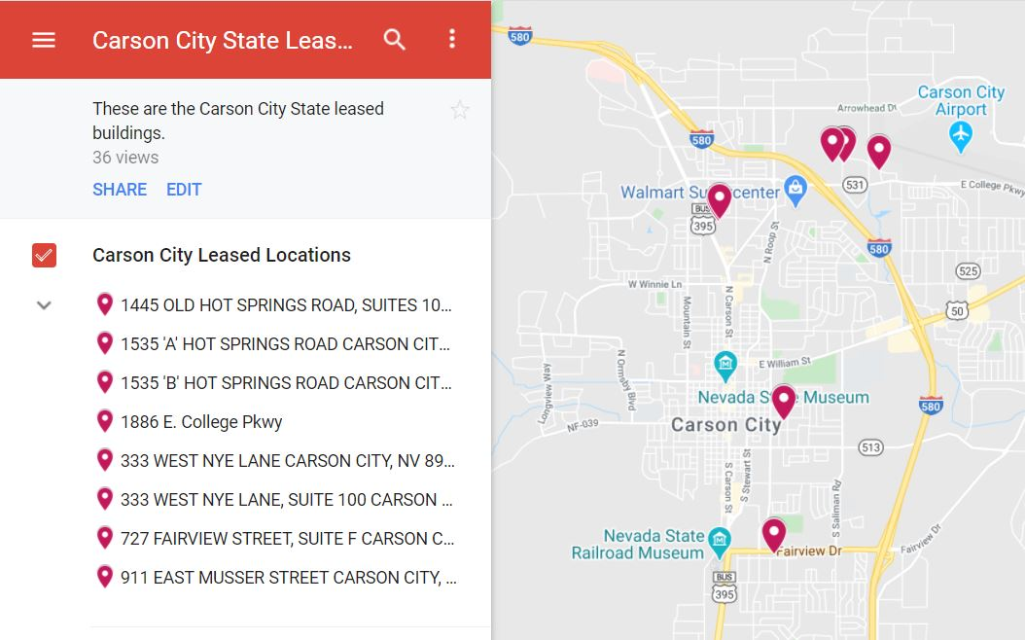
This DPS Campus Headquarters will unite Nine DPS Divisions, while adding a much-needed Forensics Lab, while providing ease of access to Nevada Citizens

Slide 4
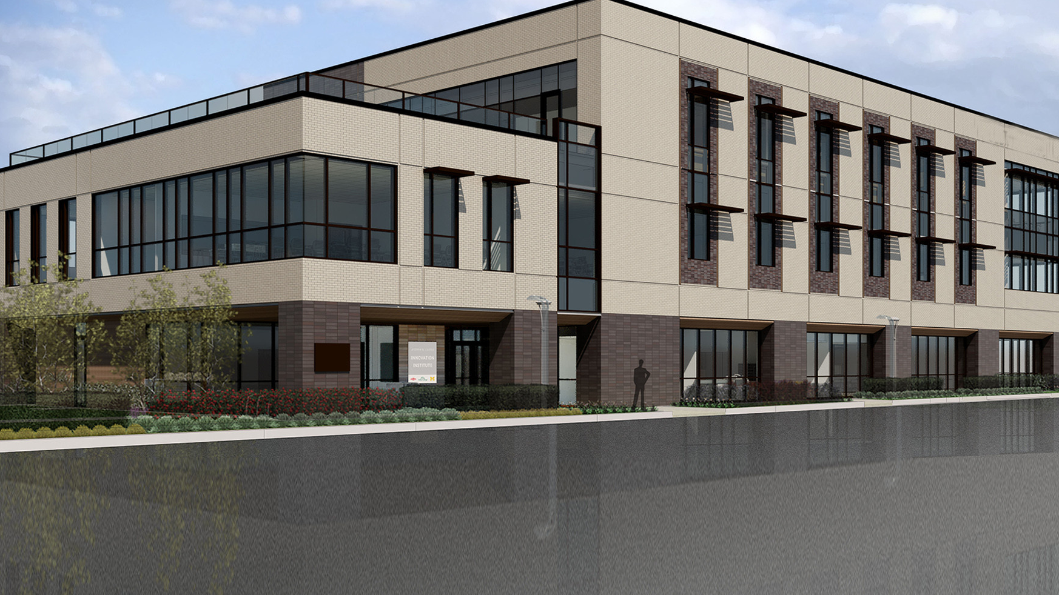
PROPOSED DPS CAMPUS HEADQUARTERS
2525 South Carson Street, Carson City

Slide 5
DPS HEADQUARTERS FEATURES
5,000 Square Foot Forensics Lab, for all State Laboratory Services
Relieving the dependency on overburdened county lab facilities
For Blood Testing for Marijuana (Cannabis), Alcohol, Controlled Substances
DNA Testing
Including the support of the Nevada Cannabis Compliance Board
Breath and Alcohol testing and equipment calibration
The forensics lab would be funded with Highway Funds and Cannabis Funds
167,000 Square Foot Headquarters Campus
Housing Nine (9) Divisions, and more than 325 positions

Slide 6
Forensics Lab Proposal
DPS Requests the construction of the Forensics Lab in the next biennium, along with funds to complete the materials testing and design of the DPS Complex, to be completed in the 2024/2025 Biennium.

Slide 7
Funding Sources, Estimated
HQ = 50% Highway Funds / 50% General Funds
Lab = 50% Highway Funds / 50% Cannabis Funds
Forensics Lab, once established, will be self funded
FY 22 - DPS will pay $1,089,295.92 in Rent to Private Companies in Carson City
Savings of these funds can contribute to the Return on Investment
of the new DPS HQ Building

Slide 8
Department of Public Safety Training Division 2021 Dormitory CIP Request
State Public Works Board Presentation
August 26, 2020

Slide 9
Need for New Dormitories
The current location of the dorms is at the Stewart Facility.
If plans move forward for the Stewart Facility, the dormitory building will no longer be available for transitional housing of cadets attending the academy and who will be relocating to rural posts. Ultimately affecting recruitment efforts for these duty posts.
The dorms are more than a mile from the training facility, where classes are held, and can be a hinderance for cadets/students that do not have available transportation.
There is no available internet, which the cadets and visiting students need for study purposes.

Slide 10
There is no air conditioning, numerous windows do not open and/or have no screens to prevent pests from entering the rooms.
The dorm has, during the past several months, had pest control out on two occasions. The first to address a rodent issue and the second to address an infestation for ants.
The Training Division provides annual recertification training for sworn and non-sworn personnel within the Department, often requiring students and instructors to travel in for distances over 60 miles away in an effort to provide quality and consistent training. Based on the travel time to attend these training courses, attendees often utilize the dorms.

Slide 11
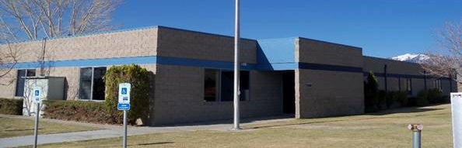
Proposed Dormitory Site 2101 Snyder Avenue, Carson City
DPS Training Facility, with existing land to support the new dorms

